Slide 1
Dean Tolp,
direktor razvoja
Stručni skup „d PRINT”
Trendovi u digitalnom tisku
26. 10. 2011. godine,
Hotel Dubrovnik
Zagreb
Grafik.NET - EPSON
Novo Partnerstvo
za Nova Digitalna Rješenja
Regionalna premijera - rješenje za tisak etiketa
Grafik.net - EPSON
Novo partnerstvo za nova digitalna rješenja

Slide 2
EPSON korporacija : globalno
dio SEIKO EPSON Korporacije , Nagano, JP započela s djelovanjem 1942.
70,000 uposlenika u 106 ureda u svijetu
ukupan godišnji promet >$10.5 milijardi
2010 – 7% reinvestirano u budućnost –R&D
Notes:
Today, we’re one of the world’s top three inkjet printer manufacturers and a leader in inkjets for both business and home.
We employ over 70,000 people in 106 companies around the world.
Our annual turnover was in excess of 11 billion dollars last year.
And every year, we spend over 6% of turnover investing in the future.

Slide 3
SEIKO EPSON korporacija – prilazi novim tržištima
Installation Video Projectors
Commercial and Industrial Printing
Visual communication
Office Printing Solutions
Value
Digital Communications
Textile Printing
2015
Home & Business
Video Projectors
Education
Photo and Personal Printing
2011
Point of Sales Solutions
2008
Productivities/Complexity
Notes:
3
Speaking of fashion, it has been fashionable recently to say that the printer market is mature and there is no more room for growth. It won’t surprise you to learn that I think the opposite is true. On the contrary, my colleagues and I see enormous opportunities ahead for digital printing.
Moving forward, we will launch a full-fledged expansion into the commercial and industrial sector based on a solid line-up of digital printer solutions for a range of applications, from signboards, posters and labels, to film for packaging and plastic bottles.
SPIEGARE COMUNCAZIONE DIGITALE CON QUARZI E SENSORI
3

Slide 4
EPSON globalno vodeće pozicije u ...
1st
Projektori
1st
Veliki format za proof
1st
A3 biznis skeneri
1st
Matrični pisači
2nd
Inkjet Printeri & MFP
Notes:
4
And we are proud to be market leaders many times over.
Since 2001, we have been the world’s number one projector manufacturer. Epson is the clear leader with market share of 20% - almost 3 times our nearest competitor.
We also are number 1, with a huge 65% market share, in large format graphics printers. Epson continues to shine in the A3 photo printer market too, with 50% market share.
Alongside this, the European business market is huge and, currently, we are market leaders for A3 business scanners.
Also, for more than 30 years, Epson has been the global leader in dot matrix and in POS printers, maintaining a commanding lead. Did you know 50% of all receipts globally are printed on Epson technology?
Finally, today we are number two, for business inkjets and multi-function devices - and our market share here is growing.
We haven’t achieved these positions without a lot of consideration into what the market wants, both now and in the future. And at Epson we believe that we can’t plan for a successful future without a strong commitment to the environment.

Slide 5
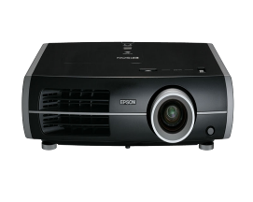
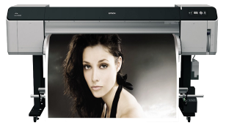
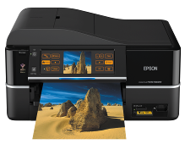
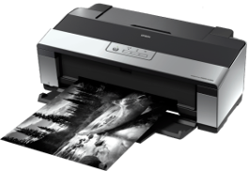
Svjetski stručnjaci u projeciranju slike i isprintu s brojnim nagradama
Najbolji pisač velikog formata
Najbolji multifunkcionalana pisač fotografija
Najbolji projektor
EH-TW5000
SP-GS6000
PX800F
Notes:
And our products regularly win awards for design. Only last year, we won no less than three TIPA awards.

Slide 6
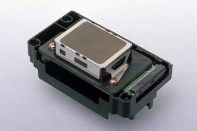
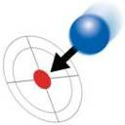
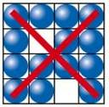
OSNOVNA TEHNOLOGIJA : EPSON MICROPIEZO pisača glava
Zašto EPSON Inkjet tehnologija ?
Standard preciznosti i trajnosti
Epson inkjet glave donose slijedeće standarde :
Minimalna
veličina kapljica
Precizan kut
apliciranja
Konstantna
veličina
Rapidno brz
snop kapljica
Bez propuštenih
mjesta
Notes:
In order to achieve a high quality printing, ink jet head need to match with following criteria.
- smallest droplet size
- accurate ejection
- uniform droplet size
- high reputation cycle
- no missing fire

Slide 7
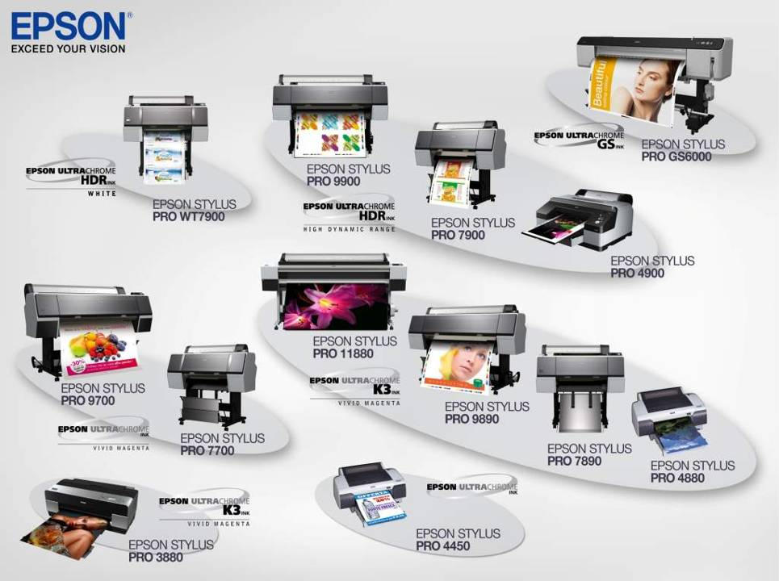
EPSON paleta Inkjet pisača za probni otisak

Slide 8
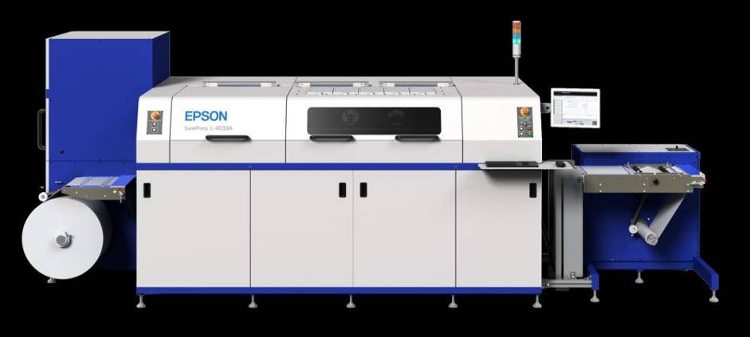
S PONOSOM PREDSTAVLJAMO
EPSON SurePress L-4033A – digitalni inkjet sustav za tisak etiketa

Slide 9
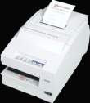
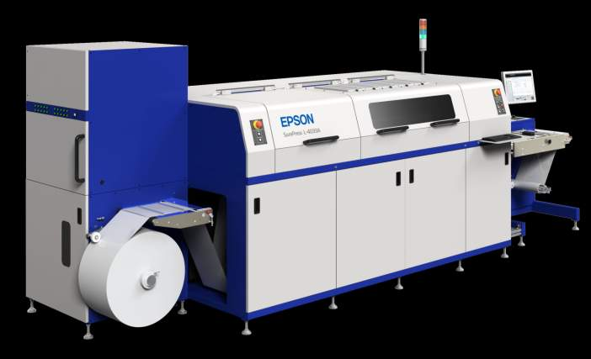
EPSON SurePress L-4033A – derivacije tehnologija i iskustva
... od pisača naljepnica
... i velikog formata
... do digitalnog
sustava za tisak
etiketa

Slide 10
EPSON SurePress L-4033A
Boje
Cijan
Žuta
Magenta
Crna
Mat crna
Naračasta
Zelena
Zaštitna tekućina
Tekućina za vlaženje
20 kazeta s bojom ukupno
Rola
Rola širine: 80mm do 330mm
Max težina role: 100kg
Max. Promjer role: 600mm (76mm osovina)
Materijali: Samoljepljive naljepnice
Debljina:100μ do 320μ zajedno s podlogom
Boje na vodenoj bazi

Slide 11
EPSON SurePress L-4033A - materijali
Papiri
Samoljepljivi papiri
Folije
Samoljepljive folije
Laminirani materijali
Premazni
Nepremazni
Strukturirani
Ostali
PE
PP
Polyolefin
PET
PVC
Tyvek
Yupo

Slide 12
EPSON SurePress L-4033A
Zašto tiskati na EPSON SurePress-u ?
Brza priprema
Varijabilni tisak
Manje naklade
Tisak na svim materijalima koji se koriste u konvencionalnom tisku
Ekološki potpuno prihvatljivo zbog boja na bazi vode
Vrhunska kvaliteta otiska

Slide 13
EPSON SurePress L-4033A
Format etikete | Cijena boje na bazi 1.000 etiketa | Brzina tiska za 1.000 etiketa
5,3 x 9 cm | 4,3 € | 6 min
8,5 x 12 cm | 14 € | 15 min

Slide 14
Grafik.NET & EPSON
Žele Vam dobrodošlicu u
Inkjet digitalni svijet
Grafik.net i EPSON
Žele Vam dobrodošlicu u
Inkjet digitalni svijet
Dean Tolp, direktor razvoja, dean.tolp@grafiknet.hr

